Slide 1
BIFX 503: Biostatistics in R
Instructor: Jennifer Schroeder, Ph.D.
Wednesdays, 5:30-8:00pm
Hodson Technology Center, Room 237
Fall 2021

Slide 2
Dealing with Unruly Data
Missing data
Non-normality, data transformations

Slide 3
Missing Data

Slide 4
Causes of Missing Data
Missing by design
Sometimes data that are expensive or difficult to obtain are collected only for a subsample
Participants drop out before study is finished or miss study visits when data is collected
Incomplete assessments, equipment failures, lost data, patients not providing consent for specimen collection, etc….

Slide 5
Problem of Missing Data
Missing data can make the sample different from the population from which it was drawn
A biased sample leads to biased results
Methods for handling missing data can introduce bias as well

Slide 6
Types of “Missingness”
Missing Completely at Random (MCAR)
The reason the data are missing is not related to any of the relevant variables in the study.
Covariate-dependent MCAR
Reason data are missing is associated with covariates only, not with treatment group or outcome
Missing at Random (MAR)
Reason for “missingness” associated with covariates and outcome variable but not with treatment group
Missing not at random (MNAR)
“Missingness” is related to the value that would have been observed

Slide 7
Assessing Missingness
Little’s Test: chi square test to evaluate whether data are MCAR
Null hypothesis: data are MCAR
If p<0.05, reject H₀, data are not MCAR
Function mcar_test(data) in package naniar
Alternative approach:
Create dummy variable missing=Yes/No
Test to see if this variable is associated with the values of other variables in the data

Slide 8
Solutions for Missing Data
Complete case analysis
Available case analysis
Single value imputation
Multiple imputation

Slide 9
Complete Case Analysis
Limit the dataset to observations with no missing data
a.k.a. listwise deletion
Estimates from complete cases are unbiased estimates of the entire sample only if data are MCAR
Otherwise, this approach compromises generalizability (external validity)

Slide 10
Available Case Analysis
Use all cases available for estimating each quantity of interest
a.k.a. pairwise deletion
E.g., all cases that have values for a pair of variables will be used for the correlation of those variables, all cases that have values for another pair of variables will be used for the correlation of those variables, etc.
Problem: each estimate is based on a slightly different sample

Slide 11
Single Value Imputation
Each missing value is replaced with a single value
Often, this is the mean of the non-missing observations
Mean value imputation
Alternatively, the missing value can be estimated based on a regression equation derived from the non-missing values
Conditional mean imputation
Problem: underestimates the uncertainty of the true underlying value
SE’s will be too small, type I error more likely

Slide 12
Multiple Imputation
Each missing value is replaced with multiple alternative values
Prediction algorithm generates imputed values
3-10 imputations recommended
Produces 3-10 unique datasets
Analyze each dataset, then combine these estimates for an overall result
Appropriately captures the amount of variability that would be present if all data had been observed

Slide 13
Imputation in R
Package mice
Function mice()
Imp <- mice(data, method= , m= )
method=algorithm for imputation
m= number of imputed values
Function with()
Evaluate an expression in an environment constructed from data
Function pool()
Combines estimates from repeated analyses

Slide 14
Imputation Sequence
Impute the missing values using mice()
Specify method and number of imputations
Calculate estimates on the completed data (observed + imputed) using with()
Summary stats, correlation, regression
Combine the estimates using pool()

Slide 15
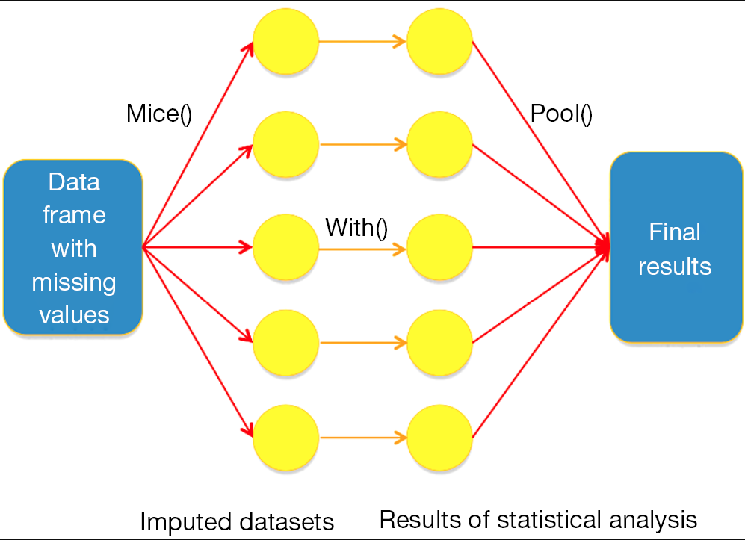
Multiple Imputation

Slide 16
Example: Blood Pressure
Dataset bp from HSAUR3 package
Variables
logdose: log10 of dose of drug
bloodbp: average SBP while drug administered
recovtime: time in minutes until patient’s SBP returned to 100 mm Hg
How do logdose and bloodbp affect recovtime
recovtime not always recorded

Slide 17
Example: Blood Pressure
Investigate missingness pattern
Evidence of MCAR?
Analyze three ways
Complete case analysis
Mean-value imputation
Multiple imputation
Compare results

Slide 18
Example: Blood Pressure
Results of MCAR test
H₀ of MCAR is rejected
Missingness (Yes/No) not associated with value of either of the other variables

Slide 19
Example: Blood Pressure
Remove all records having any missing values
na.omit()
This reduces data from 53 records to 43 records
These records are automatically excluded from regression:
 | Estimate | SE | t | p
intercept | 32.31 | 18.41 | 1.76 | 0.09
bloodp | -0.69 | 0.30 | -2.28 | 0.03
logdose | 17.8 | 7.50 | 2.37 | 0.02

Slide 20
Example: Blood Pressure
Single value imputation
Use mean
mice(bp, method=“mean”, m=1, maxit=1)
Regression results are similar:
 | Estimate | SE | t | p
intercept | 35.00 | 15.91 | 2.20 | 0.03
bloodp | -0.61 | 0.26 | -2.31 | 0.03
logdose | 13.86 | 5.96 | 2.33 | 0.02

Slide 21
Example: Blood Pressure
Multiple imputation
Use predictive mean matching
10 imputations
Set seed for reproducibility
mice(bp, method=“pmm”, m=10, print=FALSE, seed=1)
 | Estimate | SE | t | p
intercept | 34.49 | 18.95 | 1.82 | 0.08
bloodp | -0.69 | 0.29 | -2.37 | 0.02
logdose | 16.83 | 7.62 | 2.21 | 0.04

Slide 22
Example: Blood Pressure
Mean value imputation resulted in less variability
SE’s smaller
Hypothesis tests smaller p values
Multiple imputation
Larger SE’s, larger p values

Slide 23
Non-Normality & Data Transformations

Slide 24
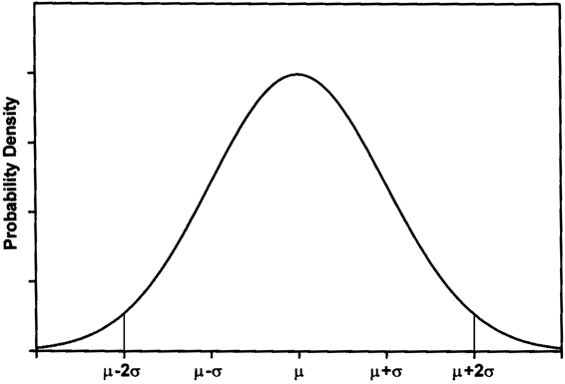
The Normal Distribution
Continuous data may follow a distribution where most of the data values fall in the middle of the range, with fewer and fewer values as you go to either extreme
This is the bell-shaped, Gaussian, or Normal distribution

Slide 25
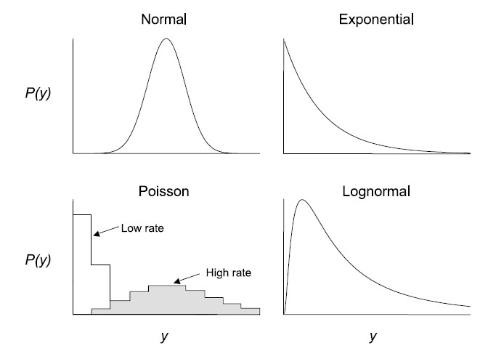
Common Distributions for Data

Slide 26
The Central Limit Theorem
The sampling distribution of any mean becomes nearly Normal as the sample size grows
Requirements:
Independent observations
Randomly collected sample

Slide 27
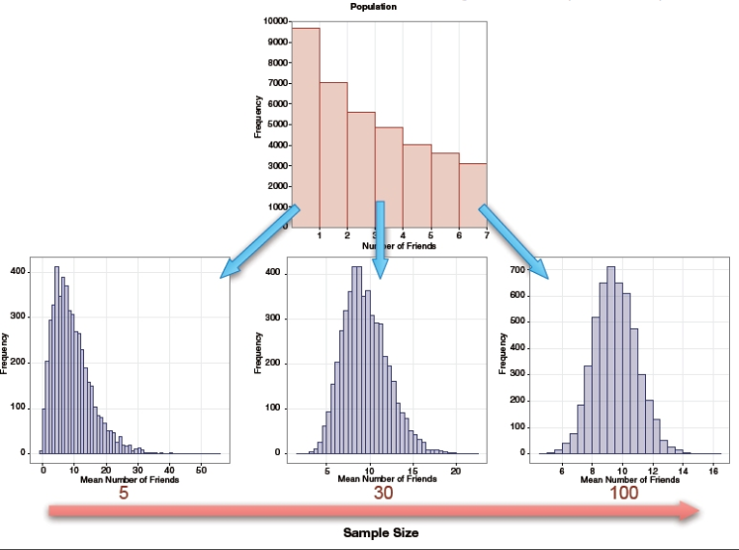

Slide 28
Application of the Central Limit Theorem
If the sample size is sufficiently large, the sample mean will be approximately normally distributed even if the underlying sample data are not.
Why is this so important? Most distributions encountered in the real world are not normal, but we can still estimate the sample mean and make inferences about it using the properties of the normal distribution, provided n is sufficiently large.

Slide 29
Why should I check my data distribution?
Normally distributed data have normally distributed means, regardless of sample size
The less ”normal” the data distribution, the more you are dependent on the Central Limit Theorem (and a large sample size)
Graphing the data distribution can also alert you to outliers and other concerns

Slide 30
Data Transformations
Many methods depend on the assumption that data is normally distributed
What to do if it’s not?
Some distributional shapes can be transformed to be more bell-shaped

Slide 31
Assessing Normality
Graphically
Histogram
Bell-shaped
QQ Plot
Plots the quantiles of your data vs. the quantiles of the normal distribution
If normal, should be a straight line

Slide 32
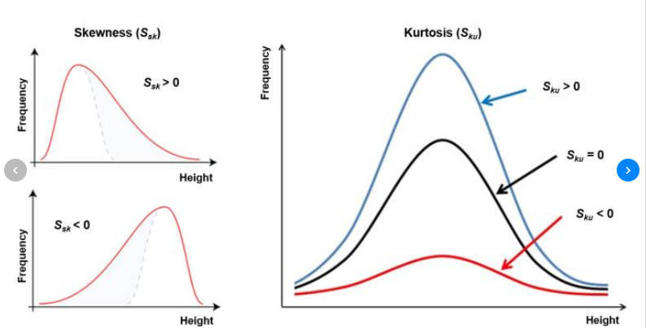
Assessing Normality
Hypothesis test
Shapiro-Wilk
Other metrics
Skewness (symmetry)
Kurtosis (flatness)

Slide 33
Assessing Normality in R
Histogram
hist()
adjust bin sizes using breaks=seq(min, max, step)
hist(airquality$Ozone, breaks=seq(0, 170, 10))
QQ plot
qqnorm()
qqnorm(airquality$Ozone)

Slide 34
Assessing Normality in R
Shapiro-Wilk Test
shapiro.test()
shapiro.test(airquality$Ozone)
small p-value (<0.05) indicates data is not normal

Slide 35
Skewness & Kurtosis
Package e1071
skewness(data$variable, na.rm=TRUE)
kurtosis (data$variable, na.rm=TRUE)

Slide 36
Tests of Normality
Caveat regarding hypothesis tests to assess normality
They can be biased
In large samples they can be significant even for relatively small deviations from normality
False positive
In small samples they can be non-significant for large deviations from normality due to low statistical power
False negative
Trust graphical methods of assessing normality more than hypothesis tests

Slide 37
Example: Air Quality Data
Evaluate whether the following distributions are normal, using histograms, QQ plots, the Shapiro-Wilk test and skewness/kurtosis:
Ozone (ppb)
Solar radiation (langleys)
Wind (mph)
Temperature (F)

Slide 38
Ozone
Right skewed
Skewness=1.21, kurtosis=1.11
Shaprio test p<0.0001

Slide 39
Solar Radiation
Left skewed, flat
Skewness=-0.42, kurtosis=-1.00
Shapiro test p<0.0001

Slide 40
Wind
Fairly symmetric and normal
Skewness=-0.37, kurtosis=-0.46
Shapiro test p=0.12

Slide 41
Temperature
Fairly symmetric
Skewness=0.34, kurtosis=0.03
Shapiro test p=0.009

Slide 42
Data Transformations
Skewed data can be transformed to be more symmetric by applying a function, such as the log or square root, to the data

Slide 43
Tukey’s Ladder of Powers
Power | Transformation | Name
2 | Y² | Square
1 | Y (Nothing) | Original data
½ | √Y | Square root
0 | log(Y) or log₁₀(Y) | Logarithm
-1/2 | -1/√Y | Reciprocal root
-1 | -1/Y | Reciprocal
-2 | -1/Y² | Reciprocal square
Go up the ladder to reduce left skewness
Go down the ladder to reduce right skewness

Slide 44
Data Transformations in R
Calculating a new variable:
E.g. adding the new variable temperature²
newvariable <- function(oldvariable)
airquality$Tempsquared <- airquality$Temp**2

Slide 45
Data Transformations in R
Useful mathematical functions:
log() natural log (base e)
log10() log base 10
sqrt() square root
abs() absolute value

Slide 46
Caveats Regarding Transformations
A transformation must be applied the same way to all values in the dataset
So relative differences stay the same and comparisons within the sample remain valid
By transforming data you change the hypotheses being tested
When using a log transformation and comparing means, you change from comparing arithmetic means to comparing geometric means

Slide 47
Note Regarding Zeroes/Negative Numbers
The log and square root transformations do not work on zeroes or on negative numbers
If you want to use these transformations on data that contain zeroes and/or negative numbers, you add a constant to all values of the data
The smallest constant to make all values >0
Use caution when a high proportion of data are zeroes – this can bias the results

Slide 48
Example
Air quality data
Ozone is right-skewed
Choose two transformations that can reduce right-skewness
Create two new transformed variables
Evaluate the normality of these new variables

Slide 49
Log Transformation
Skewness=-0.55, kurtosis=0.78, Shapiro test p=0.015
Over-corrected – now is left skewed

Slide 50
Square Root Transformation
Skewness=0.51, kurtosis=-0.48, Shapiro test p=0.0044
Neither of these transformations resulted in a normal distribution

Slide 51
Remember the CLT!
If the sample size is large enough for the Central Limit Theorem to apply, modest deviations from normality don’t need to be corrected

Slide 52
Non-Parametric Methods
If transformation doesn’t work to normalize the data, there are many alternative methods that do not rely on the normality assumption
Particularly relevant to small (n<50) samples
Called non-parametric because there are no distributional assumptions
distributions are characterized by parameters

Slide 53
Non-Parametric Methods
Many of these methods rely on ranking the data values and using these ranks for analysis instead of the original measurements
Using ranks solves the problems of outliers and skewness

Slide 54
Parametric vs. Non
Analysis | Normal method | Non-parametric alternative
Compare two independent samples | Two-sample t test | Wilcoxon rank-sum test Mann-Whitney test
Compare two dependent samples | Paired t test | Wilcoxon signed-rank test
Compare >2 independent samples | Between-subjects ANOVA | Kruskal-Wallis test
Compare >2 dependent samples | Repeated ANOVA | Friedman’s ANOVA
Quantify a linear relationship between two variables | Pearson correlation | Spearman correlation

